Slide 1

Post-Production
Freya Cassidy, Jamie Muir, Archie Thomas

Slide 2
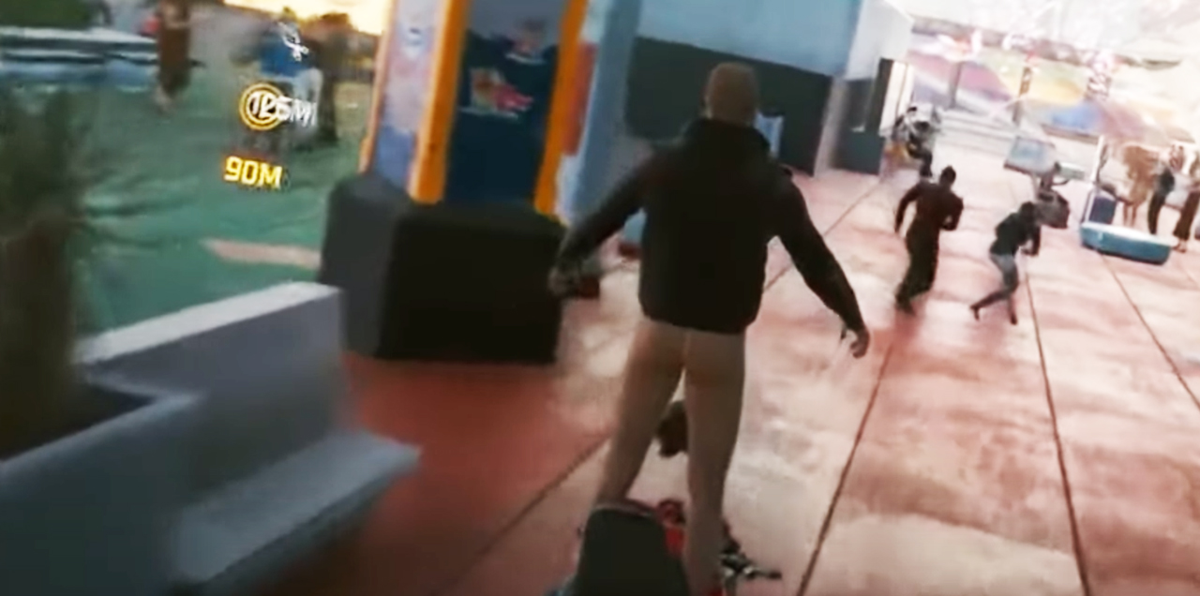
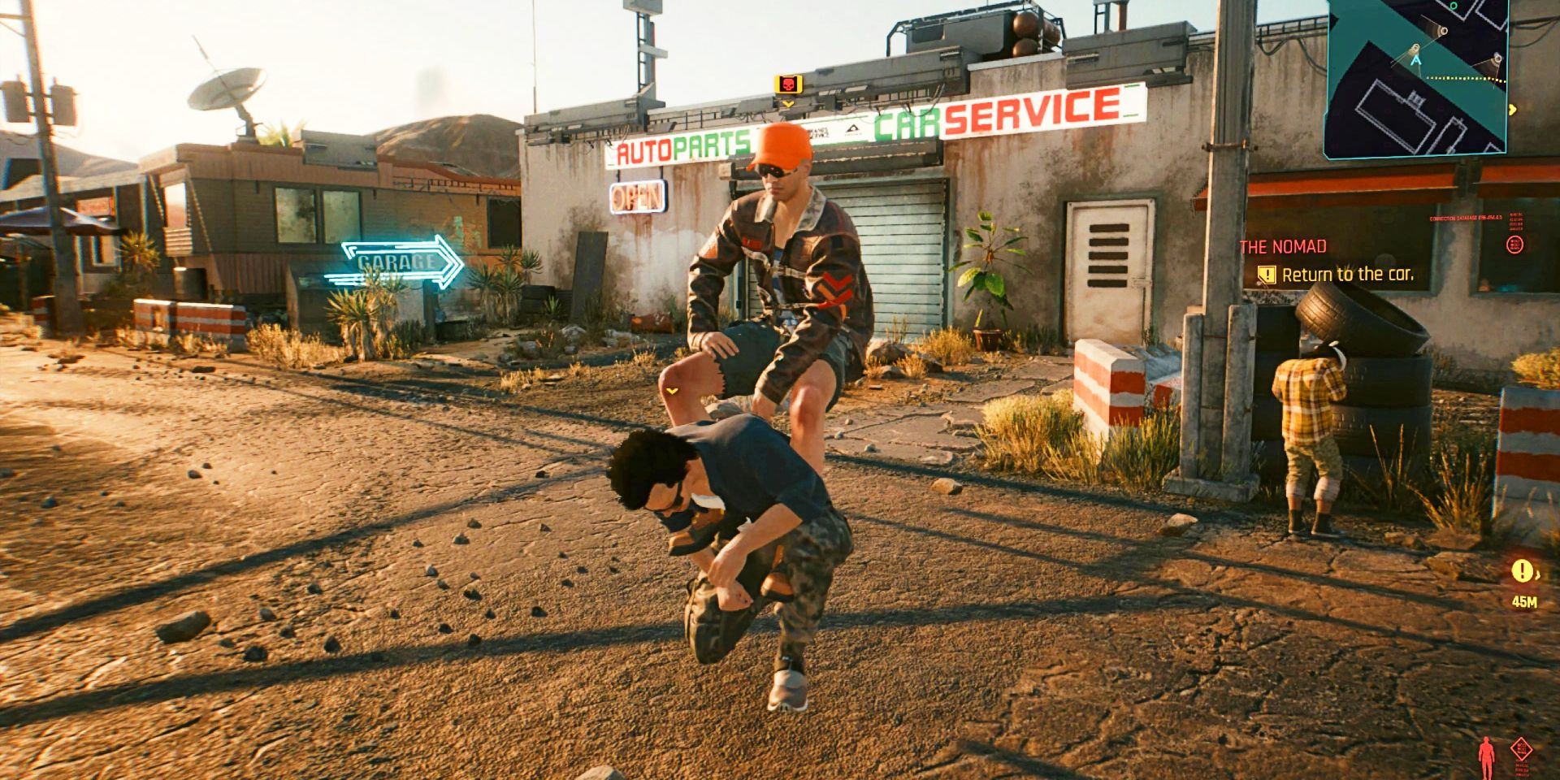
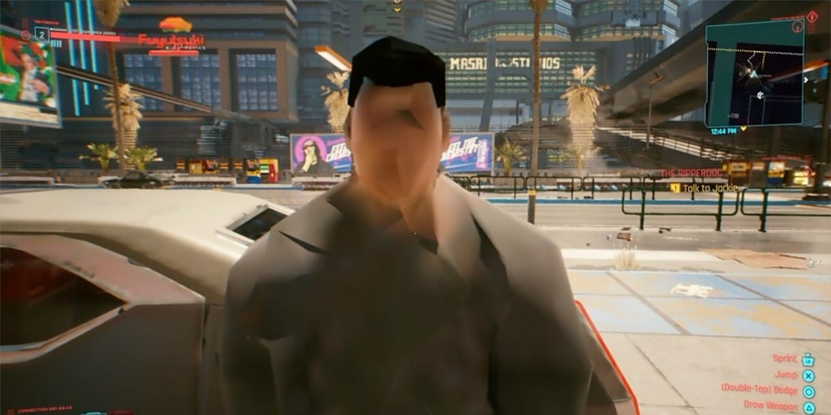
Postproduction
The role of the post-production phase in game creation focusses mainly on fixing bugs. It is mainly the minor tweaks and fixes before the game gets officially published. Sometimes this can save a game such as cyberpunk as it was released too early with many bugs. This goes for both small indie games and high up triple A games as it's hard to get them all.

Slide 3
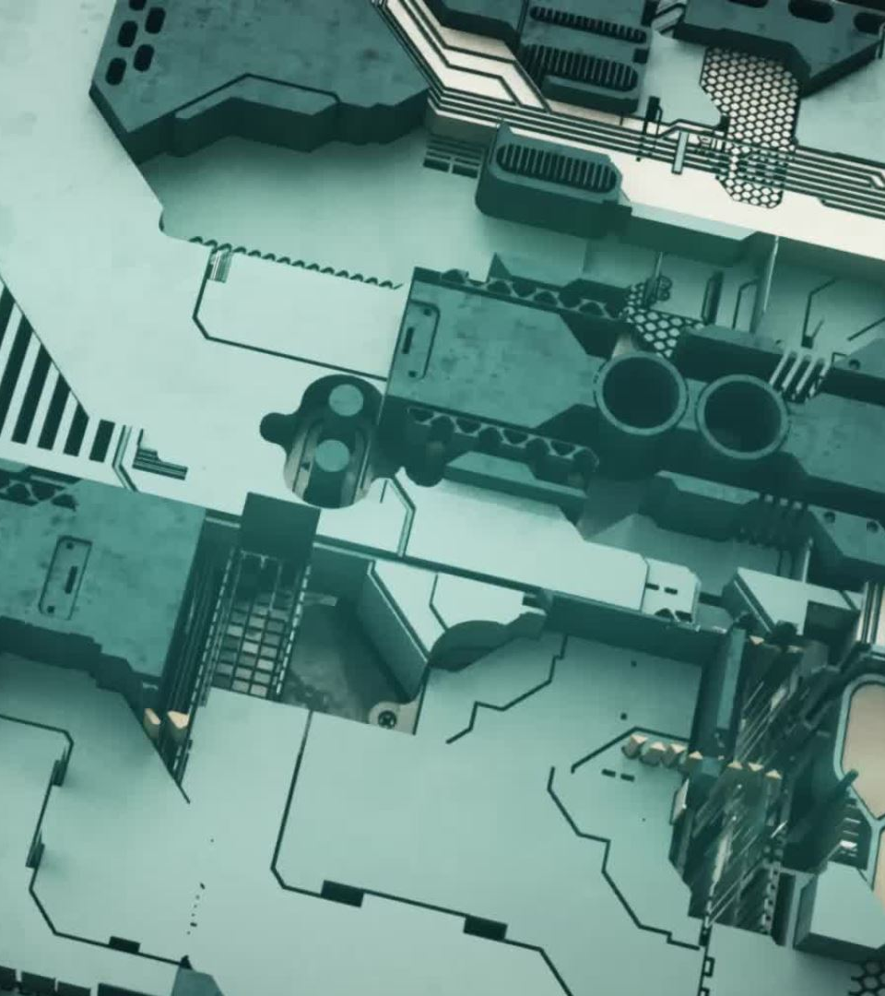
updates
Another form of post-production is game updates. These are common and can add things like DLC. many games add more game modes weapons enemies etc. However, these can also produce bugs that must be patched. However, most production is just focused on cleaning bugs. Many games get patched a lot more than people realise

Slide 4
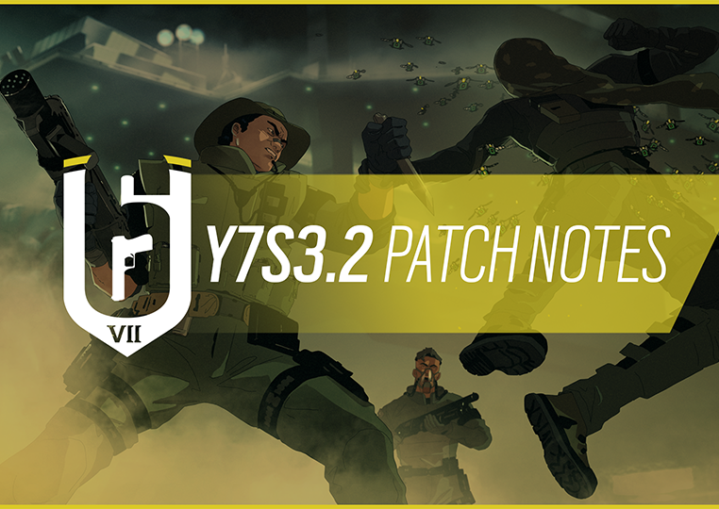
Patches
Game Devs will often tweak the game on minor scale for a better comfort of playing feeling this also ensures that there are no bugs in the game that could break the game or the immersion of the game.
These small patches will usually be added to a description either in-game or on the game companies' website
These Patches also allow the Devs to see what about the game needs changing in future updates.
Makes this transparent for the players letting them see what has changed within the game and how this will affect them.

